Slide 1
Python Packages

Slide 2

Roadmap
Array Data Structure
Data Visualization
Pandas
Descriptive Analytics in Python

Slide 3


Array Data Structure
“Fighting with a large army under your command is nowise different from fighting with a small one: it is merely a question of instituting signs and signals.”
–Sun Tzu on the Art of War

Slide 4
Array Data Structure
Concepts
One-dimensional arrays
Final exam grades of six students
 |  |  | Length is 6
61 | 52.5 | 71 |  | 32.5 | 68 |  | 64

Slide 5
Array Data Structure
Concepts
One-dimensional arrays
Final exam grades of six students
6 students
Length is 6
71 32.5 68
61 52.5
64
Index of the item is 2

Slide 6
Array Data Structure
Concepts
Two-dimensional arrays
Grades of three components of six students
 | 3 columns
18 |  | 26 | 71
25 |  | 15.5 | 12
24 |  | 27 | 20
10 |  | 5.5 | 17
27 |  | 26 | 15
22 |  | 21 | 21
6 rows

Slide 7
Array Data Structure
Concepts
Two-dimensional arrays
Grades of three components of six students
3 components
 | 3 columns
18 | 26 | 71
25 | 15.5 | 12
24 | 27 | 20
10 | 5.5 | 17
27 | 26 | 15
22 | 21 | 21
6 rows
Row index is 3 Column index is 2
6 students

Slide 8
Array Data Structure
Concepts
N-dimensional arrays
3 columns
18 | 26 | 71
25 | 15.5 | 12
24 | 27 | 20
10 | 5.5 | 17
27 | 26 | 15
22 | 21 | 21
ows r
6
Length is 6
61 52.5
Index of the item is 2
71 32.5 68 64
One-dimensional array
Row index is 3 Column index is 2
with 6 items
Two-dimensional array
with
6 × 3 = 18 items
Dimension number | Shape | Index | Item number
1
2
N
One number Two numbers
N numbers
One index Two indexes
N indexes
Shape
Shape[0] * Shape[1]
Shape[0] *…* Shape[N]

Slide 9
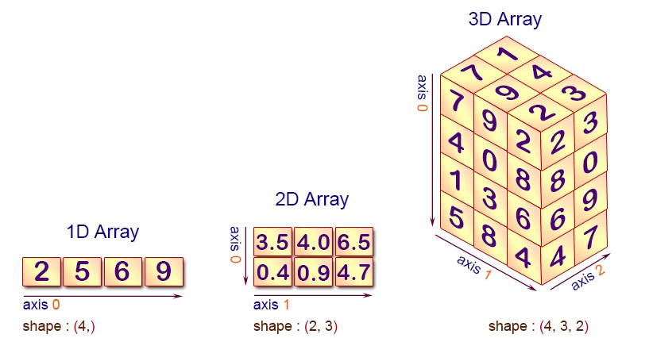

Array Data Structure
Concepts
N-dimensional arrays
shape index
= (axis0,
= [index0,
axis1, …))
index1,…]

Slide 10


Array Data Structure
Concepts
N-dimensional arrays
shape = (axis0, axis1) index = [index0, index1]

Slide 11

Array Data Structure
NumPy arrays
Import the NumPy package
import numpy as
.<function
np
np
name>

Slide 12
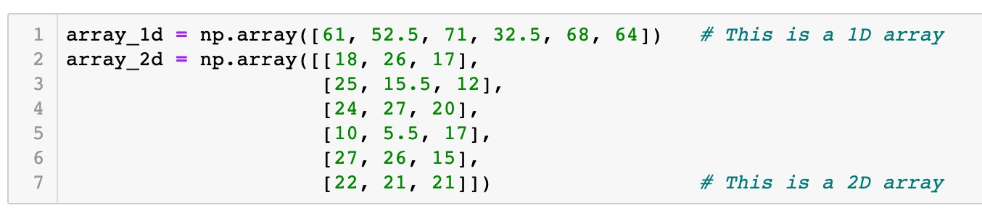
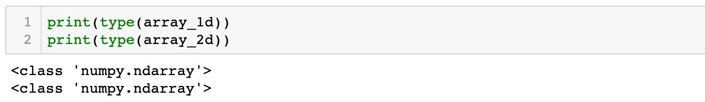

Array Data Structure
NumPy arrays
Create arrays from Python lists
Function
np.array()

Slide 13

Array Data Structure
NumPy arrays
Create arrays from Python lists
Function
np.array()
61 | 52.5 | 71 | 32.5 | 68 | 64

Slide 14
Array Data Structure
NumPy arrays
Create arrays from Python lists
Function
np.array()
18 | 26 | 71
25 | 15.5 | 12
24 | 27 | 20
10 | 5.5 | 17
27 | 26 | 15
22 | 21 | 21

Slide 15
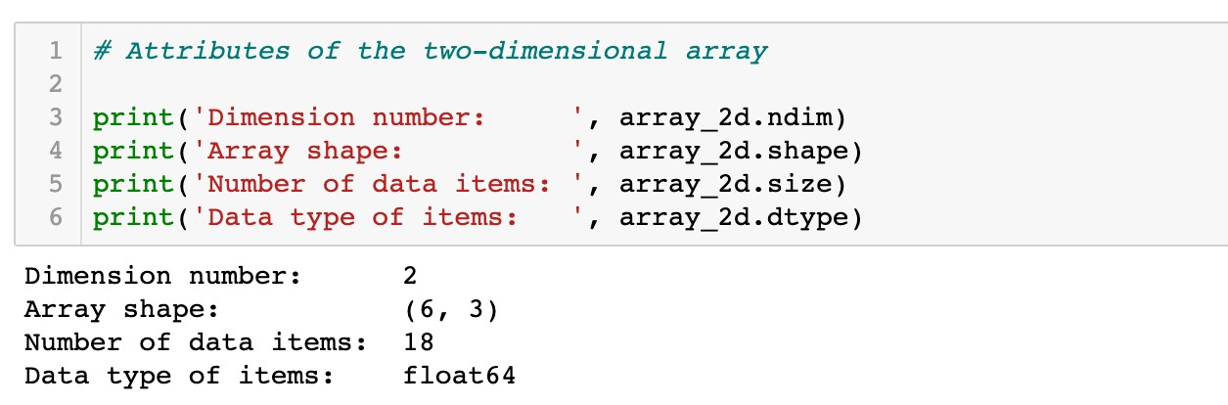
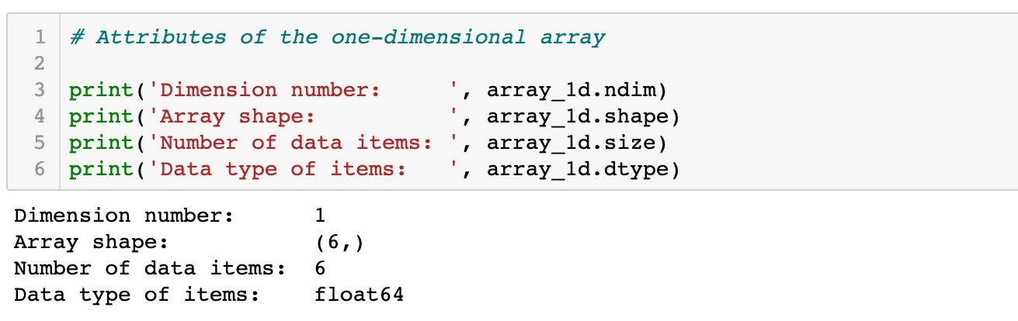
Array Data Structure
NumPy arrays
Create arrays from Python lists
Attributes of arrays

Slide 16

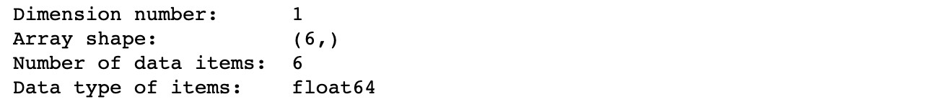
Array Data Structure
NumPy arrays
Create arrays from Python lists
Attributes of arrays
 |  | Length is 6
61 | 52.5 |  | 71 | 32.5 | 68 |  | 64
One-dimensional
array with 6 items

Slide 17
Array Data Structure
NumPy arrays
Create arrays from Python lists
Attributes of arrays
Length is 6
61 52.5
71 32.5 68 64
One-dimensional array
with 6 items
A tuple with one item

Slide 18

Array Data Structure
NumPy arrays
Create arrays from Python lists
Attributes of arrays
 |  | Length is 6
61 | 52.5 |  | 71 | 32.5 | 68 |  | 64
One-dimensional array
with 6 items

Slide 19
Array Data Structure
NumPy arrays
Create arrays from Python lists
Attributes of arrays
 |  | Length is 6
61 | 52.5 |  | 71 | 32.5 | 68 |  | 64
One-dimensional array
with 6 items
Data type: floating point numbers

Slide 20
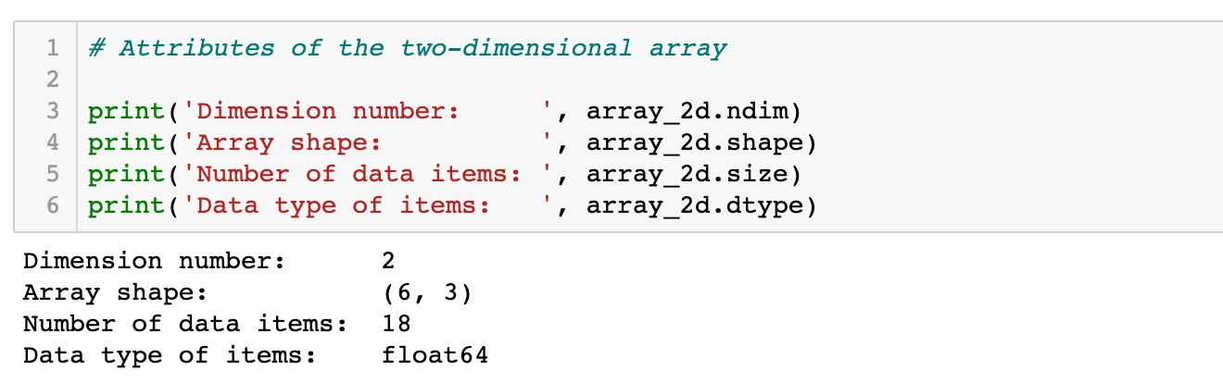
Array Data Structure
NumPy arrays
Create arrays from Python lists
Attributes of arrays

Slide 21
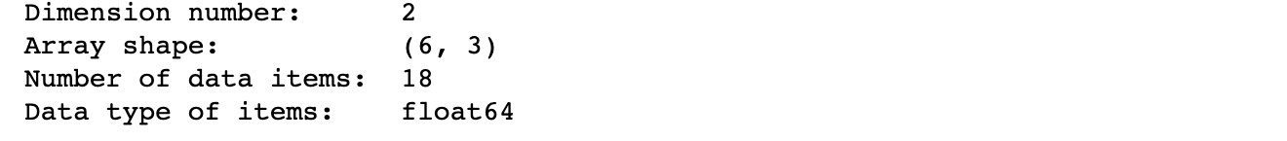
Array Data Structure
NumPy arrays
Create arrays from Python lists
Attributes of arrays
 | 3 columns
18 |  | 26 | 71
25 |  | 15.5 | 12
24 |  | 27 | 20
10 |  | 5.5 | 17
27 |  | 26 | 15
22 |  | 21 | 21
6 rows
Two-dimensional
array with 6 × 3 = 18 items

Slide 22


Array Data Structure
NumPy arrays
Create arrays from Python lists
Attributes of arrays
3 columns
18 |  | 26 | 71
25 |  | 15.5 | 12
24 |  | 27 | 20
10 |  | 5.5 | 17
27 |  | 26 | 15
22 |  | 21 | 21
ows r
6
Two-dimensional array with 6 × 3 = 18 items
axis 0

Slide 23

Array Data Structure
NumPy arrays
Create arrays from Python lists
Attributes of arrays
3 columns
18 | 26 | 71
25 | 15.5 | 12
24 | 27 | 20
10 | 5.5 | 17
27 | 26 | 15
22 | 21 | 21
ows r
6
Two-dimensional array with 6 × 3 = 18 items
axis 1

Slide 24

Array Data Structure
NumPy arrays
Create arrays from Python lists
Attributes of arrays
 | 3 columns
18 |  | 26 | 71
25 |  | 15.5 | 12
24 |  | 27 | 20
10 |  | 5.5 | 17
27 |  | 26 | 15
22 |  | 21 | 21
6 rows
Two-dimensional array
with 6 × 3 = 18 items

Slide 25
Array Data Structure
NumPy arrays
Create arrays from Python lists
Attributes of arrays
 | 3 columns
18 |  | 26 | 71
25 |  | 15.5 | 12
24 |  | 27 | 20
10 |  | 5.5 | 17
27 |  | 26 | 15
22 |  | 21 | 21
6 rows
Two-dimensional array with 6 × 3 = 18 items
Data type: floating point numbers

Slide 26
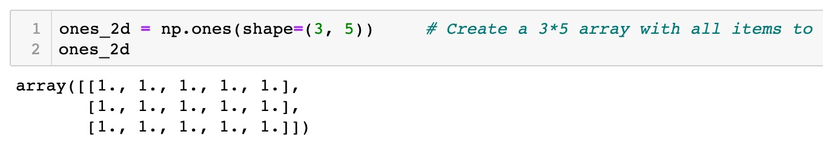
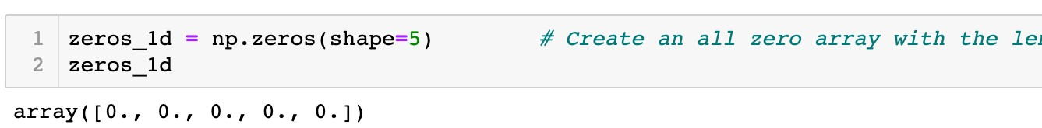
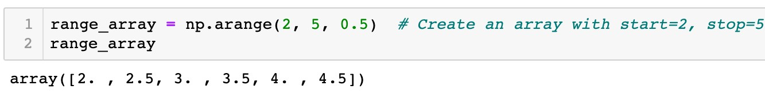
Array Data Structure
NumPy arrays
Create special arrays
A two-dimensional array: 3 rows and 5 columns
A one-dimensional array: length is 5
(start, stop, step)

Slide 27
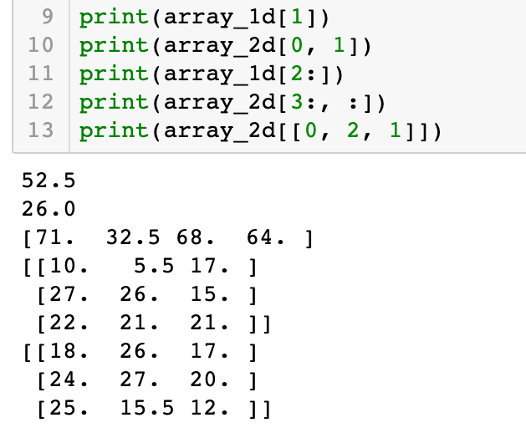
Array Data Structure
NumPy arrays
Indexing and slicing of arrays
Similar to type data
list
61 | 52.5 | 71 | 32.5 | 68 | 64
Index: 1

Slide 28
Array Data Structure
NumPy arrays
Indexing and slicing of arrays
Similar to type data
list
Row index: 0
Column index: 1
18 | 26 | 71
25 | 15.5 | 12
24 | 27 | 20
10 | 5.5 | 17
27 | 26 | 15
22 | 21 | 21

Slide 29
Array Data Structure
NumPy arrays
Indexing and slicing of arrays
Similar to type data
list
61 | 52.5 | 71 | 32.5 | 68 | 64
Index: 2:6:1

Slide 30
Array Data Structure
NumPy arrays
Indexing and slicing of arrays
Similar to type data
list
18 | 26 | 71
25 | 15.5 | 12
24 | 27 | 20
10 | 5.5 | 17
27 | 26 | 15
22 | 21 | 21
Row index: 3:6:1
Column index: 0:3:1

Slide 31
Array Data Structure
NumPy arrays
Indexing and slicing of arrays
Similar to type data
list
18 | 26 | 71
25 | 15.5 | 12
24 | 27 | 20
10 | 5.5 | 17
27 | 26 | 15
22 | 21 | 21
Row index: [0, 2, 1]
Column index: 0:3:1

Slide 32
Array Data Structure
NumPy arrays
Indexing and slicing of arrays
Similar to type data
list
18 | 26 | 71
25 | 15.5 | 12
24 | 27 | 20
10 | 5.5 | 17
27 | 26 | 15
22 | 21 | 21
Row index: [0, 2, 1]
Column index: 0:3:1
Take all columns if column index is no specified

Slide 33
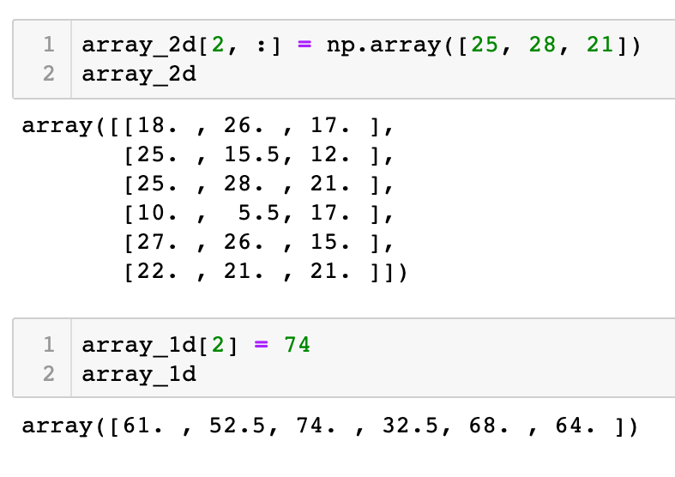
Array Data Structure
NumPy arrays
Indexing and slicing of arrays
Similar to type data
list
18 | 26 | 71
25 | 15.5 | 12
24 | 27 | 20
10 | 5.5 | 17
27 | 26 | 15
22 | 21 | 21
Items to be changed

Slide 34
Array Data Structure
NumPy arrays
Indexing and slicing of arrays
Similar to type data
list
18 | 26 | 71
25 | 15.5 | 12
25 | 28 | 21
10 | 5.5 | 17
27 | 26 | 15
22 | 21 | 21
New item values

Slide 35
Array Data Structure
NumPy arrays
Indexing and slicing of arrays
Similar to type data
list
Item to be changed
61 | 52.5 | 71 | 32.5 | 68 | 64

Slide 36
Array Data Structure
NumPy arrays
Indexing and slicing of arrays
Similar to type data
list
New item value
61 | 52.5 | 71 | 32.5 | 68 | 64

Slide 37
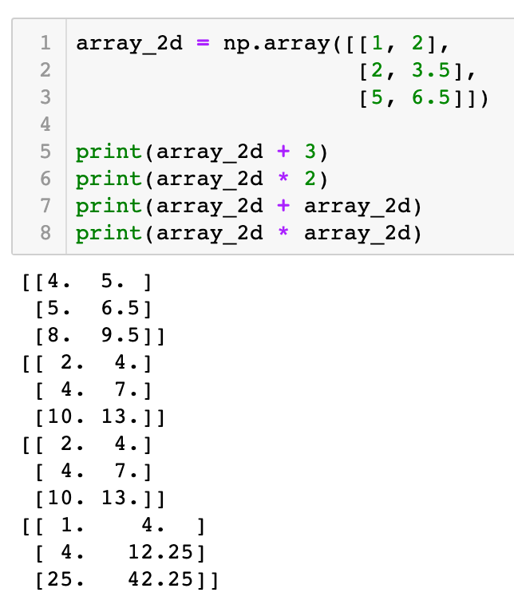
Array Data Structure
NumPy arrays
Element-wise arithmetic operations
An array and a scalar
1 | 2
2 | 3.5
5 | 6.5
4 | 5
5 | 6.5
8 | 9.5
+ 3 =
1 | 2
2 | 3.5
5 | 6.5
2 | 4
4 | 7
10 | 13
* 2 =

Slide 38
Array Data Structure
NumPy arrays
Element-wise arithmetic operations
An array and a scalar
1 | 2
2 | 3.5
5 | 6.5
1 | 2
2 | 3.5
5 | 6.5
2 | 4
4 | 7
10 | 13
+
=
1 | 2
2 | 3.5
5 | 6.5
1 | 2
2 | 3.5
5 | 6.5
1 | 4
4 | 12.25
25 | 42.25
*
=

Slide 39

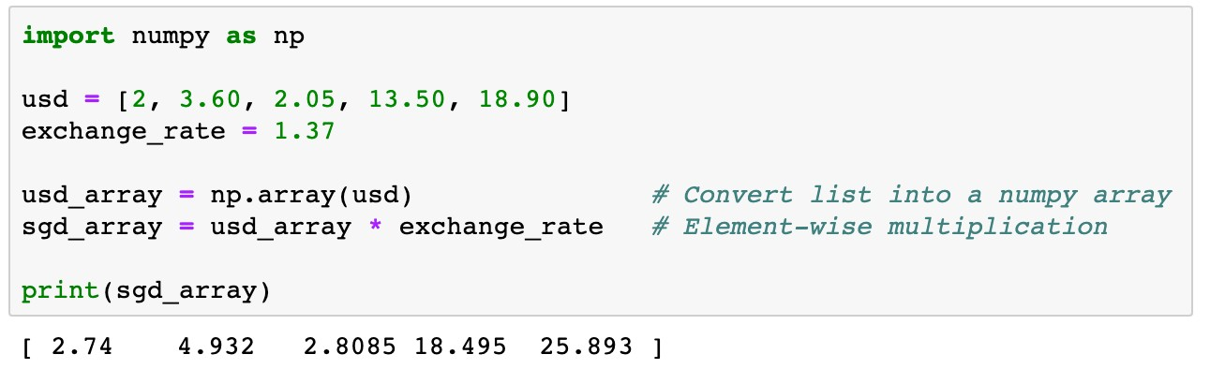
Array Data Structure
NumPy arrays
Element-wise arithmetic operations
Example 1
usd is a list of containing five money transactions in US dollars. Transfer each transaction into Singapore dollars.

Slide 40

Array Data Structure
NumPy arrays
Element-wise arithmetic operations
2 | 3.60 | 2.05 | 13.50 | 18.90

Slide 41

Array Data Structure
NumPy arrays
Element-wise arithmetic operations
2 | 3.60 | 2.05 | 13.50 | 18.90
* 1.37

Slide 42
Array Data Structure
NumPy arrays
Element-wise arithmetic operations
2.74 | 4.932 | 2.8085 | 18.495 | 25.893

Slide 43
Array Data Structure
NumPy arrays
Element-wise arithmetic operations
More concise
Easier to read
Faster to execute than loops

Slide 44

Array Data Structure
NumPy arrays
Element-wise arithmetic operations
Example 2
The discrete distribution information of two types of newspapers is stored in a two-dimensional array distr. The first row represents the probabilities of each weather condition, the second and third rows give the corresponding newspaper demands. Calculate 1) the expected newspaper demands; 2) the standard deviations of newspaper demands; and 3) the expected total profit with the given parameters

Slide 45
Array Data Structure
NumPy arrays
Element-wise arithmetic operations
Sunny Cloudy Raining
Thunderstorm
Haze
0.315 | 0.226 | 0.289 | 0.087 | 0.083
560 | 530 | 389 | 202 | 278
533 | 486 | 386 | 234 | 263
Probabilities
Paper1 Paper2
Two-dimensional array
distr

Slide 46
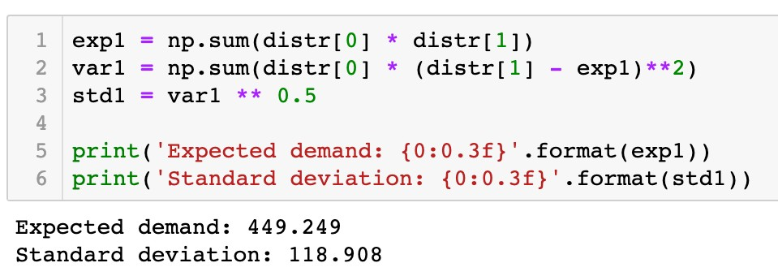
Array Data Structure
NumPy arrays
Element-wise arithmetic operations
Sunny Cloudy Raining
Thunderstorm
Haze
0.315 | 0.226 | 0.289 | 0.087 | 0.083
560 | 530 | 389 | 202 | 278
533 | 486 | 386 | 234 | 263
Probabilities
Paper1 Paper2
Two-dimensional array
distr

Slide 47
Array Data Structure
NumPy arrays
Element-wise arithmetic operations
Sunny Cloudy Raining
Thunderstorm
Haze
533 | 486 | 386 | 234 | 263
0.315 0.226 0.289 0.087 0.083
Probabilities
Paper1 Paper2
Two-dimensional array
560 530 389 202 278
distr

Slide 48
Array Data Structure
NumPy arrays
Element-wise arithmetic operations
Sunny Cloudy Raining
Thunderstorm
Haze
533 | 486 | 386 | 234 | 263
Probabilities
Paper1 Paper2
0.315 0.226 0.289 0.087 0.083
560 530 389 202 278
-exp1 | -exp1 | -exp1 | -exp1 | -exp1
560
530
389
202
278

Slide 49
Array Data Structure
NumPy arrays
Element-wise arithmetic operations
Sunny Cloudy Raining
Thunderstorm
Haze
533 | 486 | 386 | 234 | 263
Probabilities
Paper1 Paper2
0.315 0.226 0.289 0.087 0.083
560 530 389 202 278
( | -exp1)**2 | ( | -exp1)**2 | ( | -exp1)**2 | ( | -exp1)**2 | ( | -exp1)**2
560
530
389
202
278

Slide 50
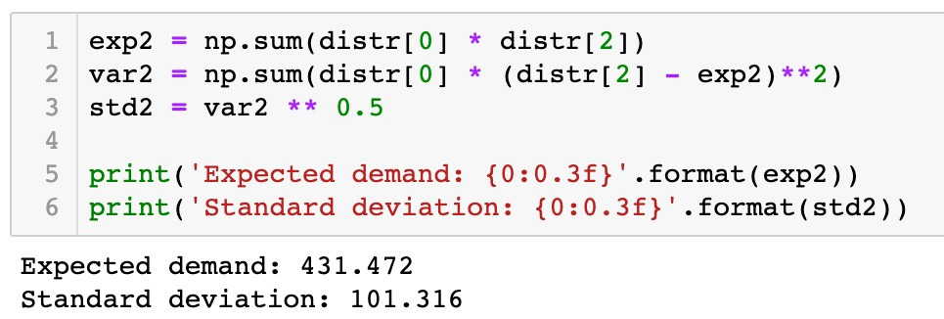
Array Data Structure
NumPy arrays
Element-wise arithmetic operations
Sunny Cloudy Raining
Thunderstorm
Haze
560 | 530 | 389 | 202 | 278
Probabilities
Paper1 Paper2
0.315 0.226 0.289 0.087 0.083
533 486 386 234 263
( | -exp2)**2 | ( | -exp2)**2 | ( | -exp2)**2 | ( | -exp2)**2 | ( | -exp2)**2
533
486
386
234
263

Slide 51



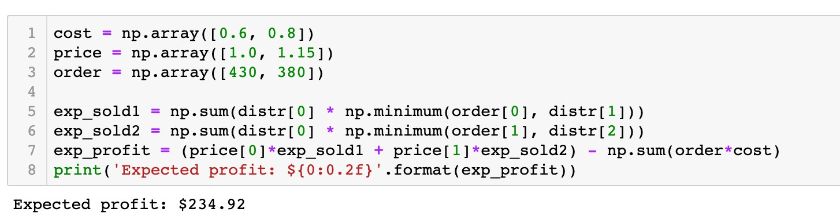
Array Data Structure
NumPy arrays
Element-wise arithmetic operations
distr[1]
560 530 389 202 278
order[0]
430
430 430 389 202 278

Slide 52

Array Data Structure
NumPy arrays
Element-wise arithmetic operations
distr[2]
533 486 386 234 263
order[1]
380
380 380 380 234 263

Slide 53



Array Data Structure
NumPy arrays
Element-wise arithmetic operations
cost
order
0.6 0.8
430 380
0.6*430 0.8*380

Slide 54
Array Data Structure
NumPy arrays
Element-wise arithmetic operations

Slide 55
Array Data Structure
NumPy arrays
Broadcasting
An array and a scalar
1 | 2
2 | 3.5
5 | 6.5
4 | 5
5 | 6.5
8 | 9.5
+
3
=
Two arrays of the same shape
1 | 2
2 | 3.5
5 | 6.5
1 | 2
2 | 3.5
5 | 6.5
2 | 4
4 | 7
10 | 13
+
=

Slide 56
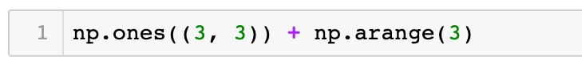
Array Data Structure
NumPy arrays
Broadcasting
Two arrays of diﬀerent same shapes
1 | 1 | 1
1 | 1 | 1
1 | 1 | 1
0 | 1 | 2
+
np.arange(3)
np.ones((3, 3))

Slide 57
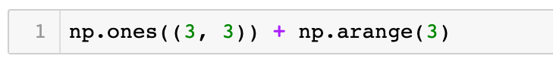
Array Data Structure
NumPy arrays
Broadcasting
Two arrays of diﬀerent same shapes
Broadcasting
Duplicate the smaller array
1 | 1 | 1
1 | 1 | 1
1 | 1 | 1
1 | 1 | 1
1 | 1 | 1
1 | 1 | 1
0 | 1 | 2
0 | 1 | 2
0 | 1 | 2
+
0 | 1 | 2
=
+
np.arange(3)
np.ones((3, 3))

Slide 58
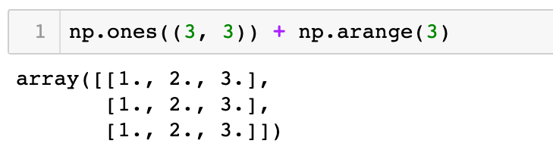
Array Data Structure
NumPy arrays
Broadcasting
Two arrays of diﬀerent same shapes
1 | 1 | 1
1 | 1 | 1
1 | 1 | 1
1 | 1 | 1
1 | 1 | 1
1 | 1 | 1
0 | 1 | 2
0 | 1 | 2
0 | 1 | 2
1 | 2 | 3
1 | 2 | 3
1 | 2 | 3
+
0 | 1 | 2
=
+
=
np.arange(3)
np.ones((3, 3))

Slide 59
Array Data Structure
NumPy arrays
Broadcasting
Two arrays of diﬀerent same shapes
0 | 1 | 2
np.arange(3)

Slide 60
Array Data Structure
NumPy arrays
Broadcasting
Two arrays of diﬀerent same shapes
1
0
3
1
Shape is changed from (3, ) to (3, 1)
2
np.arange(3).reshape
((3, 1)
)

Slide 61
Array Data Structure
NumPy arrays
Broadcasting
Two arrays of diﬀerent same shapes
0
1
+
0 | 1 | 2
2

Slide 62
Array Data Structure
NumPy arrays
Broadcasting
Two arrays of diﬀerent same shapes
Broadcasting Duplicate columns
0
0 | 0 | 0
1 | 1 | 1
2 | 2 | 2
0 | 1 | 2
0 | 1 | 2
0 | 1 | 2
1
+
0 | 1 | 2
=
+
2
Broadcasting Duplicate rows

Slide 63
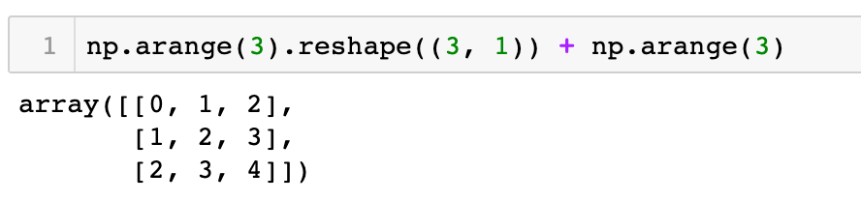
Array Data Structure
NumPy arrays
Broadcasting
Two arrays of diﬀerent same shapes
0
0 | 0 | 0
1 | 1 | 1
2 | 2 | 2
0 | 1 | 2
0 | 1 | 2
0 | 1 | 2
0 | 1 | 2
1 | 2 | 3
2 | 3 | 4
1
+
0 | 1 | 2
=
+
=
2

Slide 64
Array Data Structure
NumPy arrays
Broadcasting
An array and a scalar, interpreted by broadcasting
Broadcasting Duplicate items
0 | 1 | 2
+
5
=
0 | 1 | 2
+
5 | 5 | 5

Slide 65
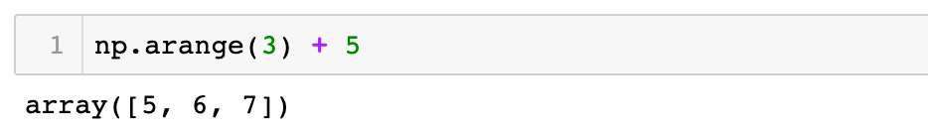
Array Data Structure
NumPy arrays
Broadcasting
An array and a scalar, interpreted by broadcasting
✓
0 | 1 | 2
+
5
=
0 | 1 | 2
+
5 | 5 | 5
=
5 | 6 | 7

Slide 66
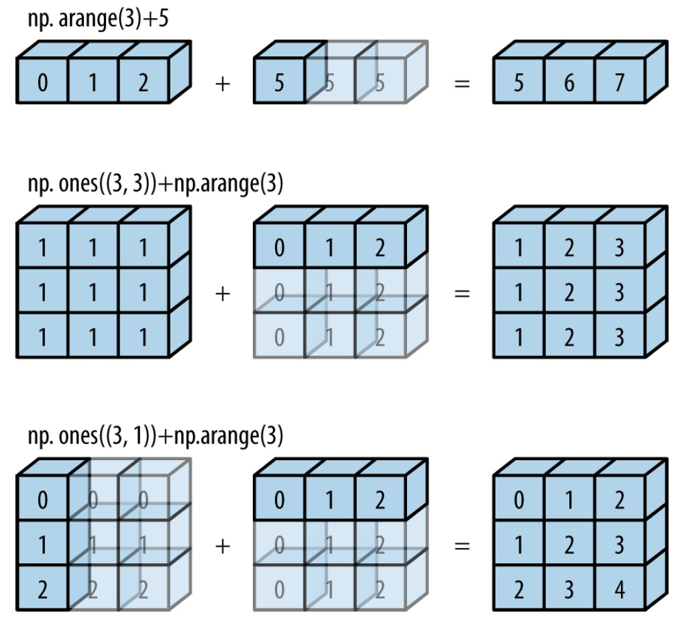
Array Data Structure
NumPy arrays
Broadcasting

Slide 67
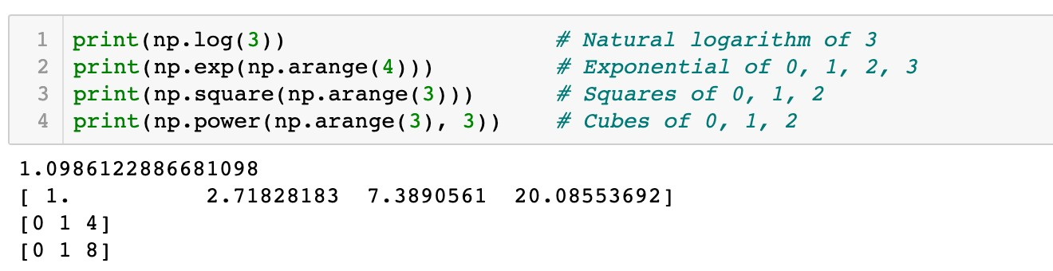
Array Data Structure
NumPy arrays
Functions and array methods
Math functions

Slide 68
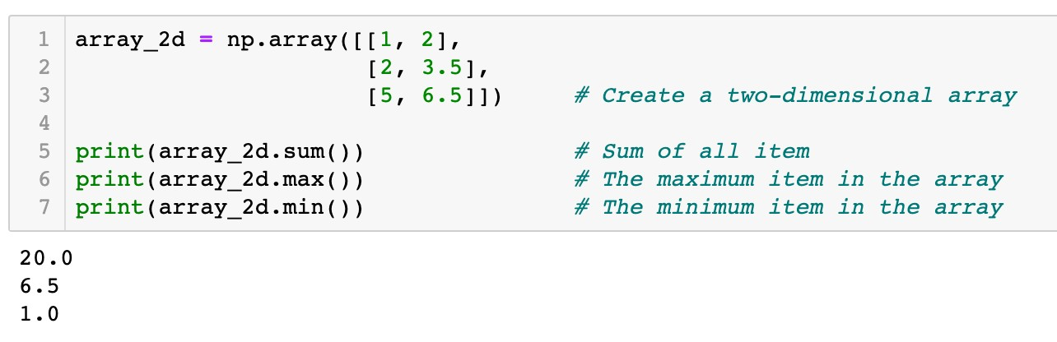
Array Data Structure
NumPy arrays
Functions and array methods
Aggregation methods

Slide 69
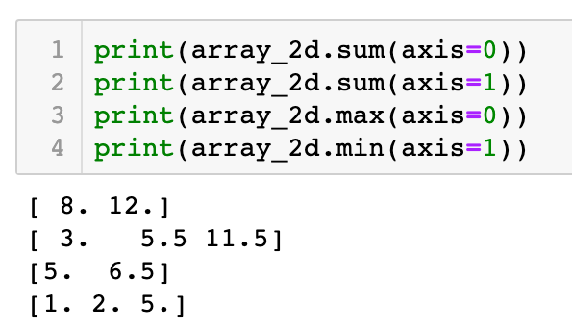
Array Data Structure
NumPy arrays
Functions and array methods
Aggregation methods
axis1
1 | 2
2 | 3.5
5 | 6.5
axis0

Slide 70
Array Data Structure
NumPy arrays
Functions and array methods
Aggregation methods
1 | 2
2 | 3.5
5 | 6.5
axis0
8.0 12.0

Slide 71
Array Data Structure
NumPy arrays
Functions and array methods
Aggregation methods
axis1
1 | 2
2 | 3.5
5 | 6.5
3
5.5
11.5

Slide 72
Array Data Structure
NumPy arrays
Functions and array methods
Aggregation methods
1 | 2
2 | 3.5
5 | 6.5
axis0
5 6.5

Slide 73
Array Data Structure
NumPy arrays
Functions and array methods
Aggregation methods
axis1
1 | 2
2 | 3.5
5 | 6.5
1.0
2.0
5.0

Slide 74
Array Data Structure
NumPy arrays
Functions and array methods
Example 2
The discrete distribution information of two types of newspapers is stored in a two-dimensional array distr. The first row represents the probabilities of each weather condition, the second and third rows give the corresponding newspaper demands. Calculate 1) the expected newspaper demands; 2) the standard deviations of newspaper demands; and 3) the expected total profit with the given parameters

Slide 75
Array Data Structure
NumPy arrays
Functions and array methods
Sunny Cloudy
Raining
Thunderstorm
Haze
0.315 | 0.226 | 0.289 | 0.087 | 0.083
560 | 530 | 389 | 202 | 278
533 | 486 | 386 | 234 | 263
Probabilities
Paper1 Paper2
Two-dimensional array
distr

Slide 76


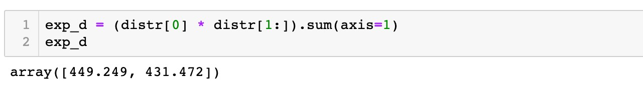
Array Data Structure
NumPy arrays
Functions and array methods
Sunny Cloudy
Raining
Thunderstorm
Haze
0.315 0.226 0.289 0.087 0.083
Probabilities
Paper1 Paper2
Two-dimensional array
*
560 530 389 202 278
533 486 386 234 263
distr
0.315 0.226 0.289 0.087 0.083
560 530 389 202 278
533 486 386 234 263

Slide 77

Array Data Structure
NumPy arrays
Functions and array methods
Sunny Cloudy
Raining
Thunderstorm
Haze
0.315 0.226 0.289 0.087 0.083
Probabilities
Paper1 Paper2
Two-dimensional array
*
Broadcasting
560 530 389 202 278
533 486 386 234 263
distr
0.315 0.226 0.289 0.087 0.083
0.315 0.226 0.289 0.087 0.083
560 530 389 202 278
533 486 386 234 263

Slide 78

Array Data Structure
NumPy arrays
Functions and array methods
Sunny Cloudy
Raining
Thunderstorm
Haze
0.315 | 0.226 | 0.289 | 0.087 | 0.083
560 | 530 | 389 | 202 | 278
533 | 486 | 386 | 234 | 263
Probabilities
Paper1 Paper2
Two-dimensional array
axis1
distr
0.315*560 0.226*530 0.289*389 0.087*202 0.083*278
0.315*533 0.226*486 0.289*386 0.087*234 0.083*263

Slide 79
Array Data Structure
NumPy arrays
Functions and array methods
Sunny Cloudy
Raining
Thunderstorm
Haze
0.315 | 0.226 | 0.289 | 0.087 | 0.083
560 | 530 | 389 | 202 | 278
533 | 486 | 386 | 234 | 263
Probabilities
Paper1 Paper2
Two-dimensional array
axis1
distr
0.315*560 0.226*530 0.289*389 0.087*202 0.083*278
0.315*533 0.226*486 0.289*386 0.087*234 0.083*263
449.249
431.472

Slide 80


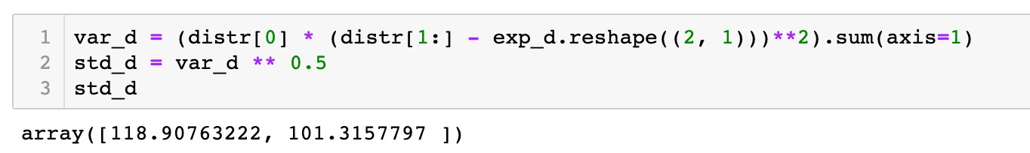
Array Data Structure
NumPy arrays
Functions and array methods
Sunny Cloudy
Raining
Thunderstorm
Haze
0.315 | 0.226 | 0.289 | 0.087 | 0.083
560 | 530 | 389 | 202 | 278
533 | 486 | 386 | 234 | 263
Probabilities
Paper1 Paper2
Two-dimensional array
distr
560 530 389 202 278
533 486 386 234 263
449.249
431.472
-

Slide 81

Array Data Structure
NumPy arrays
Functions and array methods
Sunny Cloudy
Raining
Thunderstorm
Haze
0.315 | 0.226 | 0.289 | 0.087 | 0.083
560 | 530 | 389 | 202 | 278
533 | 486 | 386 | 234 | 263
Probabilities
Paper1 Paper2
Two-dimensional array
distr
560 530 389 202 278
533 486 386 234 263
560 530 389 202 278
533 486 386 234 263
449.249 449.249 449.249 449.249 449.249
431.472 431.472 431.472 431.472 431.472
-
Broadcasting

Slide 82

Array Data Structure
NumPy arrays
Functions and array methods
Sunny Cloudy
Raining
Thunderstorm
Haze
0.315 | 0.226 | 0.289 | 0.087 | 0.083
560 | 530 | 389 | 202 | 278
533 | 486 | 386 | 234 | 263
Probabilities
Paper1 Paper2
Two-dimensional array
distr
560-449.249 530-449.249 389-449.249 202-449.249 278-449.249
533-431.472 486-431.472 386-431.472 234-431.472 263-431.472

Slide 83

Array Data Structure
NumPy arrays
Functions and array methods
Sunny Cloudy
Raining
Thunderstorm
Haze
0.315 | 0.226 | 0.289 | 0.087 | 0.083
560 | 530 | 389 | 202 | 278
533 | 486 | 386 | 234 | 263
Probabilities
Paper1 Paper2
Two-dimensional array
distr
(560-449.249)**2 (530-449.249)**2 (389-449.249)**2 (202-449.249)**2 (278-449.249)**2 (533-431.472)**2 (486-431.472)**2 (386-431.472)**2 (234-431.472)**2 (263-431.472)**2

Slide 84
Array Data Structure
NumPy arrays
Functions and array methods
Sunny Cloudy
Raining
Thunderstorm
Haze
560 | 530 | 389 | 202 | 278
533 | 486 | 386 | 234 | 263
0.315 0.226 0.289 0.087 0.083
Probabilities
Paper1 Paper2
Two-dimensional array
axis1
distr
(560-449.249)**2 (530-449.249)**2 (389-449.249)**2 (202-449.249)**2 (278-449.249)**2 (533-431.472)**2 (486-431.472)**2 (386-431.472)**2 (234-431.472)**2 (263-431.472)**2

Slide 85


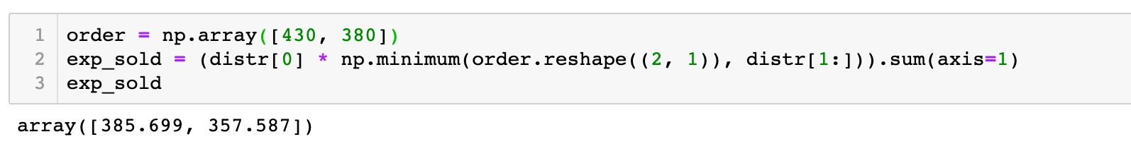
Array Data Structure
NumPy arrays
Functions and array methods
Sunny Cloudy
Raining
Thunderstorm
Haze
0.315 | 0.226 | 0.289 | 0.087 | 0.083
Probabilities
Paper1 Paper2
Two-dimensional array
560 530 389 202 278
533 486 386 234 263
distr
430
380
560 530 389 202 278
533 486 386 234 263

Slide 86
Array Data Structure
NumPy arrays
Functions and array methods
Sunny Cloudy
Raining
Thunderstorm
Haze
0.315 | 0.226 | 0.289 | 0.087 | 0.083
Probabilities
Paper1 Paper2
Two-dimensional array
560 530 389 202 278
533 486 386 234 263
distr
430 430 430 430 430
380 380 380 380 380
560 530 389 202 278
533 486 386 234 263
Broadcasting

Slide 87


Array Data Structure
NumPy arrays
Functions and array methods
Sunny Cloudy
Raining
Thunderstorm
Haze
560 | 530 | 389 | 202 | 278
533 | 486 | 386 | 234 | 263
0.315 0.226 0.289 0.087 0.083
Probabilities
Paper1 Paper2
Two-dimensional array
*
distr
0.315 0.226 0.289 0.087 0.083
430 430 389 202 278
380 380 380 234 263

Slide 88

Array Data Structure
NumPy arrays
Functions and array methods
Sunny Cloudy
Raining
Thunderstorm
Haze
560 | 530 | 389 | 202 | 278
533 | 486 | 386 | 234 | 263
0.315 0.226 0.289 0.087 0.083
Probabilities
Paper1 Paper2
Two-dimensional array
*
Broadcasting
distr
0.315 0.226 0.289 0.087 0.083
0.315 0.226 0.289 0.087 0.083
430 430 389 202 278
380 380 380 234 263

Slide 89

Array Data Structure
NumPy arrays
Functions and array methods
Sunny Cloudy
Raining
Thunderstorm
Haze
0.315 | 0.226 | 0.289 | 0.087 | 0.083
560 | 530 | 389 | 202 | 278
533 | 486 | 386 | 234 | 263
Probabilities
Paper1 Paper2
Two-dimensional array
axis1
distr
0.315*430 0.226*430 0.289*389 0.087*202 0.083*278
0.315*380 0.226*380 0.289*380 0.087*234 0.083*263
385.699
357.587

Slide 90
Roadmap
Array Data Structure
Data Visualization
Pandas
Descriptive Analytics in Python

Slide 91
Data Visualization

Slide 92

Data Visualization
Data Visualization Packages
Import the Matplotlib package
import
matplotlib.pyplot as
plt
plt
.<function name>
Other package
Plotly
Seaborn

Slide 93

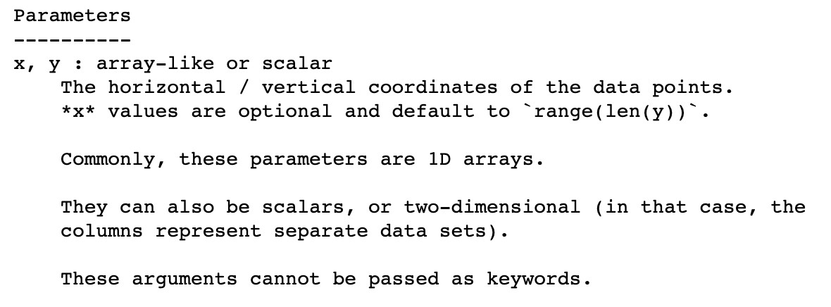
Data Visualization
Functions
Line plot
plot()
,
scatter()
, and
bar()
✓
help()
information of
plot()

Slide 94

Data Visualization
Functions
Line plot
plot()
,
scatter()
, and
bar()
Example 3
Plot the graph of an exponential function y = exp(x), where
x = 0,1,2,3,4,5.

Slide 95
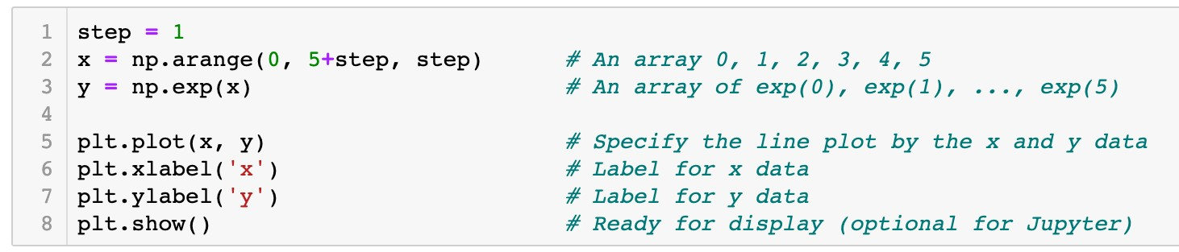
Data Visualization
Functions
Line plot
plot()
,
scatter()
, and
bar()
Example 3
Plot the graph of an exponential function y = exp(x), where
x = 0,1,2,3,4,5.

Slide 96
Data Visualization
Functions
Line plot
plot()
,
scatter()
, and
bar()
x
0 1 2 3 4 5

Slide 97
Data Visualization
Functions
Line plot
plot()
,
scatter()
, and
bar()
x
0 1 2 3 4 5
y
exp(0) exp(1) exp(2) exp(3) exp(4) exp(5)

Slide 98

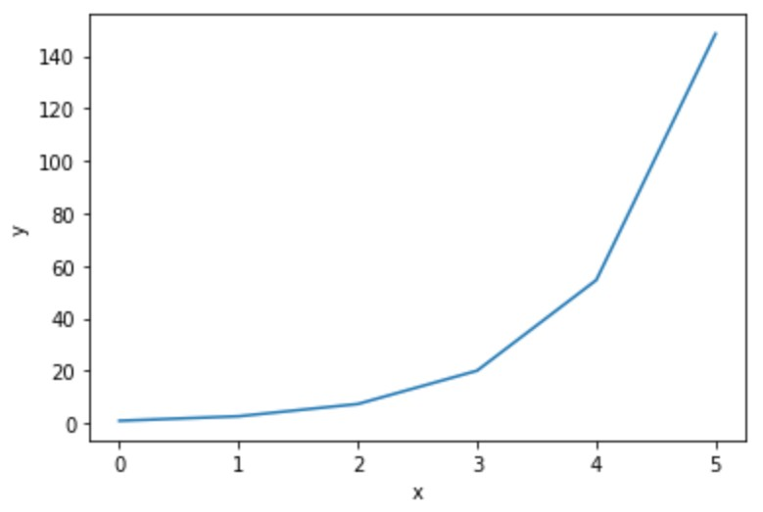
Data Visualization
Functions
Line plot
plot()
,
scatter()
, and
bar()
x
0 1 2 3 4 5
y
exp(0) exp(1) exp(2) exp(3) exp(4) exp(5)
(x[0], y[0])

Slide 99
Data Visualization
Functions
Line plot
plot()
,
scatter()
, and
bar()
x
0 1 2 3 4 5
y
exp(0) exp(1) exp(2) exp(3) exp(4) exp(5)
(x[1], y[1])

Slide 100
Data Visualization
Functions
Line plot
plot()
,
scatter()
, and
bar()
x
0 1 2 3 4 5
y
exp(0) exp(1) exp(2) exp(3) exp(4) exp(5)
(x[2], y[2])

Slide 101
Data Visualization
Functions
Line plot
plot()
,
scatter()
, and
bar()
x
0 1 2 3 4 5
y
exp(0) exp(1) exp(2) exp(3) exp(4) exp(5)
(x[5], y[5])

Slide 102
Data Visualization
Functions
Line plot
plot()
,
scatter()
, and
bar()
x
0 1 2 3 4 5
y
exp(0) exp(1) exp(2) exp(3) exp(4) exp(5)

Slide 103
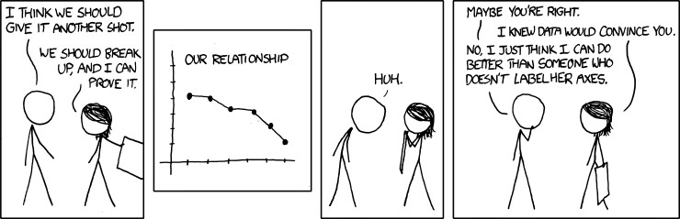
Data Visualization
Functions
plot()
,
scatter()
, and
bar()

Slide 104
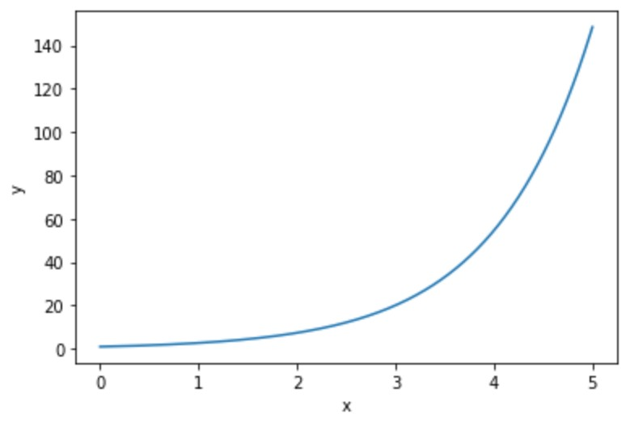
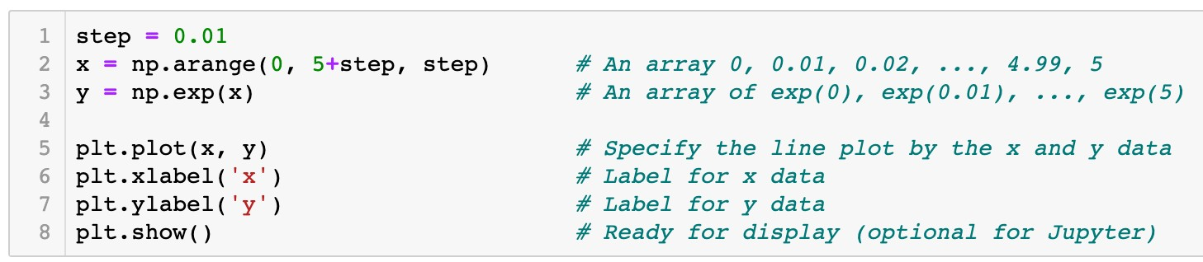
Data Visualization
Functions
Line plot
plot()
,
scatter()
, and
bar()
x
0 0.01 0.02 … 5
y
exp(0) exp(0.01) exp(0.02) … exp(5)

Slide 105
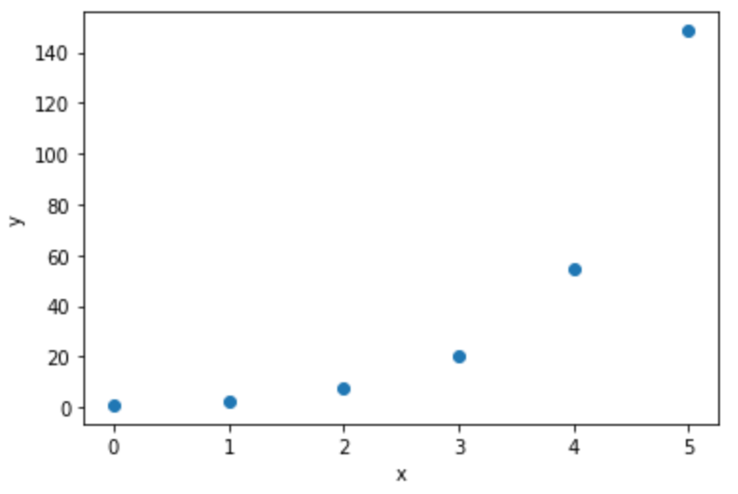
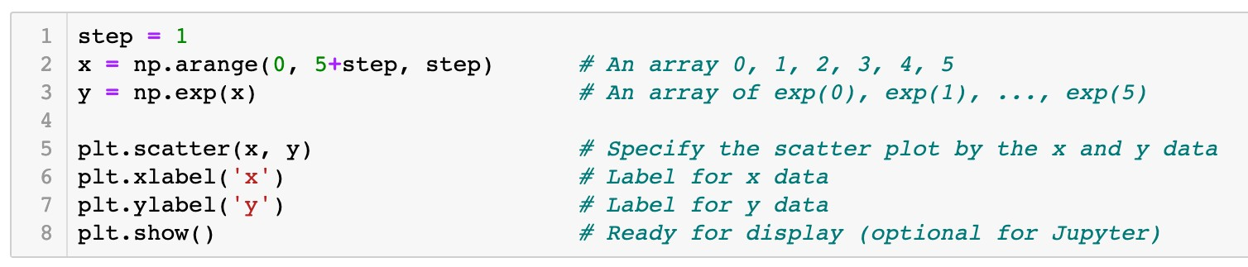
Data Visualization
Functions
plot()
,
scatter()
, and
bar()
Scatter plot
x
0 1 2 3 4 5
y
exp(0) exp(1) exp(2) exp(3) exp(4) exp(5)

Slide 106
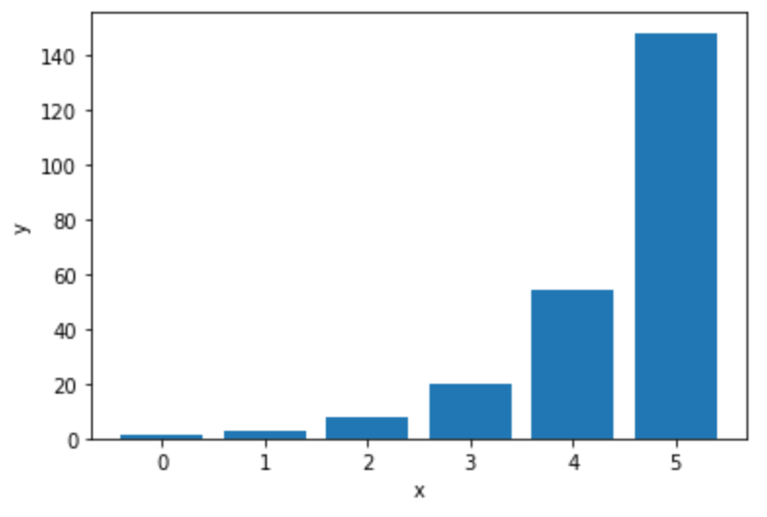
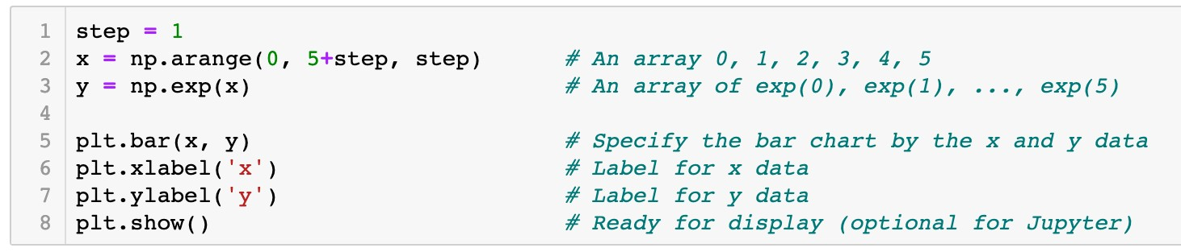
Data Visualization
Functions
plot()
,
scatter()
, and
bar()
Bar graph
x
0 1 2 3 4 5
y
exp(0) exp(1) exp(2) exp(3) exp(4) exp(5)

Slide 107

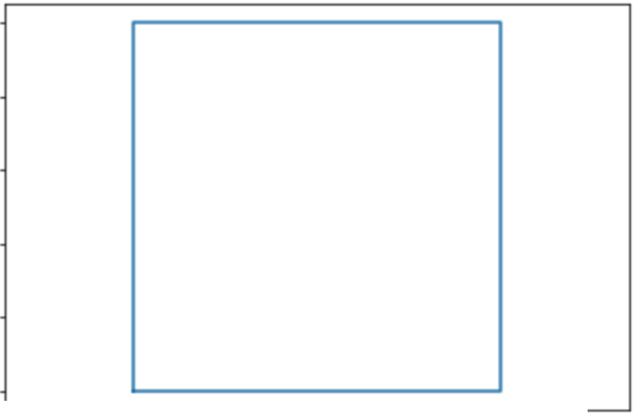
Data Visualization
Question
Which of the following code plots a square as the graph shows?
A.plt.plot([O , 0, 1, 1, O ],
[ 0 '
1, 0, 1, O ])
B. plt.plot([O , 1, 1, 0, O ], _{[ 0 '}
0 , 1, 1, 0 ] )
c. plt.plot([O , 1, 1, 0]' [0'o , 1, 11 )
D. plt.plot([O , 1, 1, O ], [O , 1, 1, O 1 )
LO
08
06
04
02
00
-0 2
00
02 04
06
08 LO
L2

Slide 108


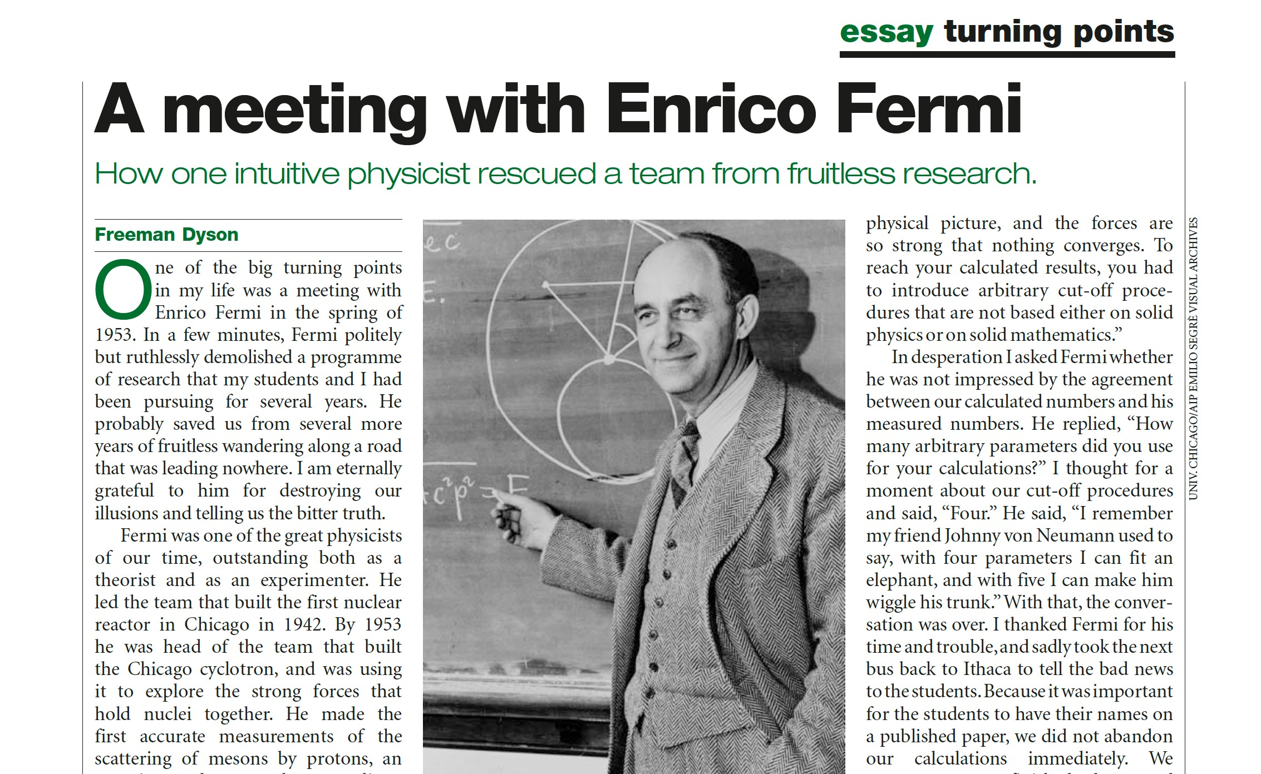


Data Visualization
Functions
Example 2
plot()
,
scatter()
, and
bar()
Draw an “elephant” with four parameters.
Enrico Fermi
Freeman Dyson

Slide 109


Data Visualization
Functions
plot()
,
scatter()
, and
bar()
“With four parameters I can fit an elephant, and with five I can make him wiggle his trunk”
-John von Neumann

Slide 110

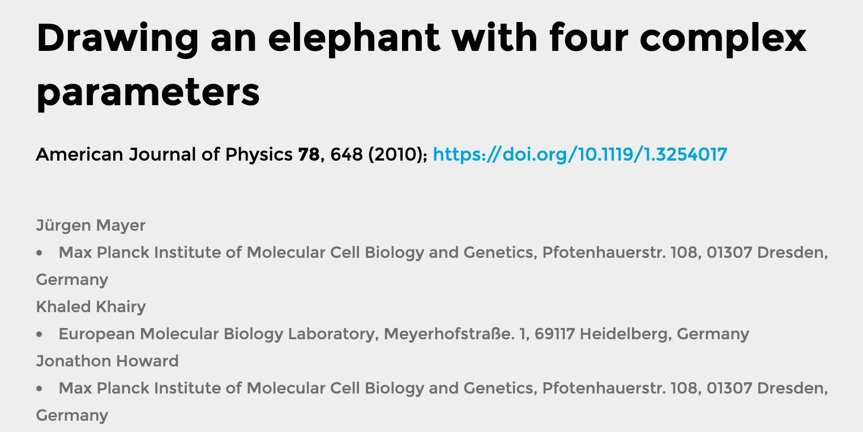
Data Visualization
Functions
plot()
,
scatter()
, and
bar()

Slide 111


Data Visualization
Functions
plot()
,
scatter()
, and
bar()
x = − 30 sin(t) + 8 sin(2t) − 10 sin(3t) − 60 cos(t)
{y = − 50 sin(t) − 18 sin(2t) − 12 cos(3t) + 14 cos(5t)
where t ∈ [0, 2π].

Slide 112
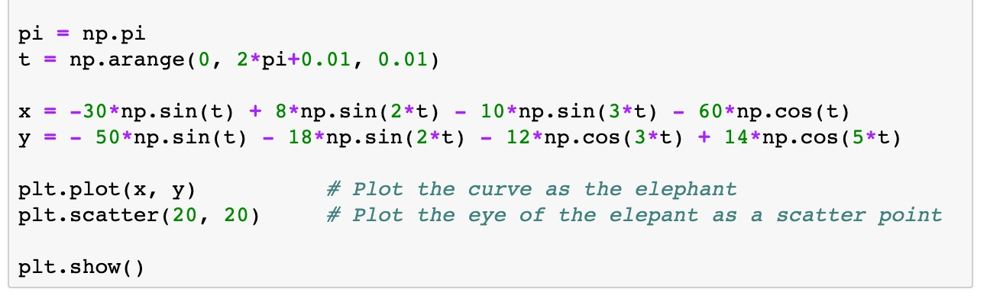
Data Visualization
Functions
plot()
scatter()
bar()
, , and
x = − 30 sin(t) + 8 sin(2t) − 10 sin(3t) − 60 cos(t)
{y = − 50 sin(t) − 18 sin(2t) − 12 cos(3t) + 14 cos(5t)
where .
An array running from 0 to 2π
t ∈ [0, 2π]

Slide 113
Data Visualization
Functions
plot()
,
scatter()
, and
bar()
x = − 30 sin(t) + 8 sin(2t) − 10 sin(3t) − 60 cos(t)
{y = − 50 sin(t) − 18 sin(2t) − 12 cos(3t) + 14 cos(5t)
where t ∈ [0, 2π].

Slide 114
Data Visualization
Functions
plot()
scatter()
bar()
, , and
x = − 30 sin(t) + 8 sin(2t) − 10 sin(3t) − 60 cos(t)
where t ∈ [0, 2π].
{y = − 50 sin(t) − 18 sin(2t) − 12 cos(3t) + 14 cos(5t)

Slide 115

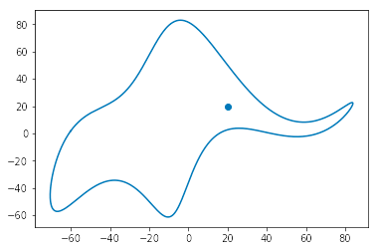
Data Visualization
Functions
plot()
scatter()
bar()
, , and
x = − 30 sin(t) + 8 sin(2t) − 10 sin(3t) − 60 cos(t)
{y = − 50 sin(t) − 18 sin(2t) − 12 cos(3t) + 14 cos(5t)
where t ∈ [0, 2π].

Slide 116
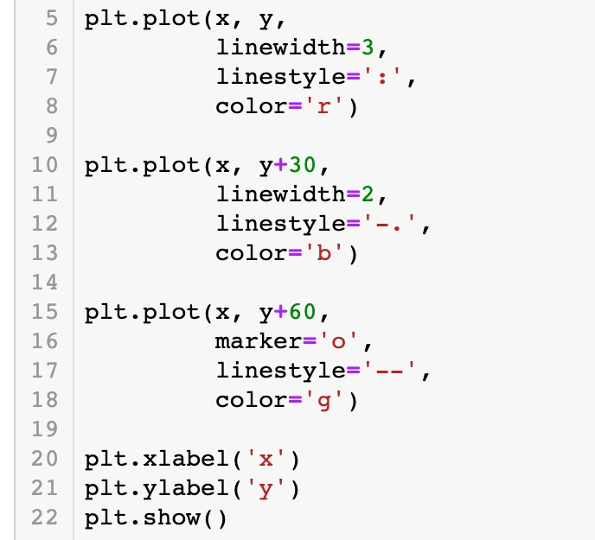
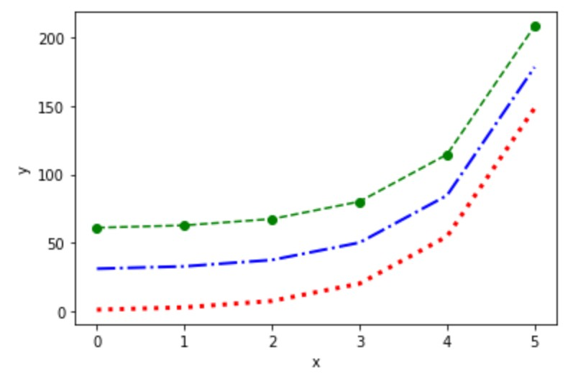
Data Visualization
Configuration of plots and figures
Specify the line plot by keyword arguments

Slide 117
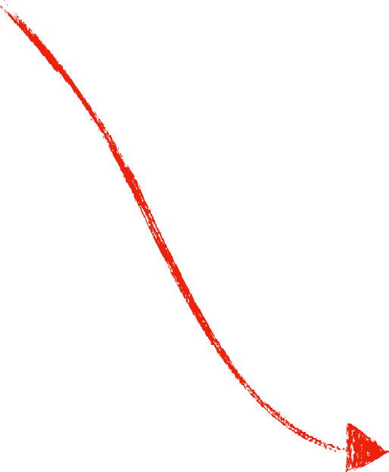
Data Visualization
Configuration of plots and figures
Specify the line plot by keyword arguments
Line width is 3 Dotted line
Line color is red

Slide 118

Data Visualization
Configuration of plots and figures
Specify the line plot by keyword arguments
Line width is 2 Dash-dotted line Line color is blue

Slide 119

Data Visualization
Configuration of plots and figures
Specify the line plot by keyword arguments
Circle marker Dashed line
Line color is green

Slide 120
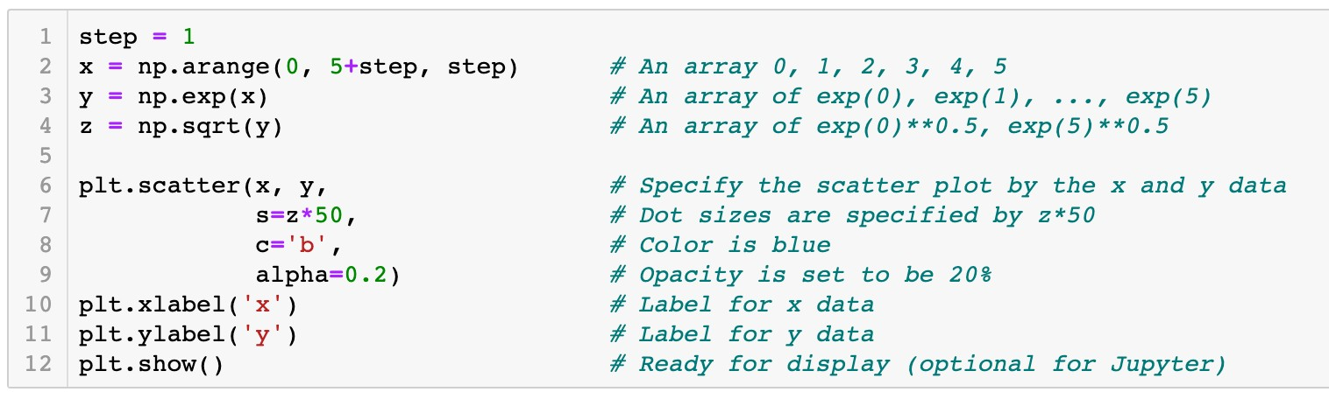
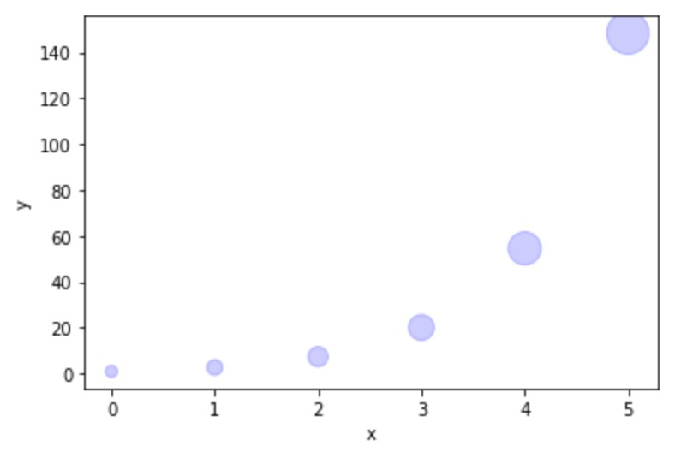
Data Visualization
Configuration of plots and figures
Specify the scatter plot by keyword arguments
Size of scatter dots

Slide 121
Data Visualization
Configuration of plots and figures
Specify the scatter plot by keyword arguments
Color of scatter dots

Slide 122
Data Visualization
Configuration of plots and figures
Specify the scatter plot by keyword arguments
Opacity of dots

Slide 123


Data Visualization
Configuration of plots and figures
Specify the bar graph by keyword arguments
Bar width is 0.6

Slide 124
Data Visualization
Configuration of plots and figures
Specify the bar graph by keyword arguments
Color of bar graph

Slide 125
Data Visualization
Configuration of plots and figures
Specify the bar graph by keyword arguments
Opacity of bar graph

Slide 126


Data Visualization
Configuration of plots and figures
Components of a figure
Figure
yticklabel
title
yticks
xticks
ylabel
xticklabel
xlabel

Slide 127



Data Visualization
Configuration of plots and figures
Attributes of a figure

Slide 128

Data Visualization
Configuration of plots and figures
Attributes of a figure
7
3.5

Slide 129
Data Visualization
Configuration of plots and figures
Attributes of a figure

Slide 130
Data Visualization
Configuration of plots and figures
Attributes of a figure

Slide 131



Data Visualization
Labeling plots and the function
legend()
legend

Slide 132



Data Visualization
Labeling plots and the function
Connection between plots and labels
legend()
legend

Slide 133


Data Visualization
Example 5
The discrete distribution information of two types of newspapers is stored in the dictionary distr_d ict. Use a bar graph to show the demands of these two types of
newspapers under different weather conditions.
{'weather' : ['Sunny', 'Cloudy', 'Raining', 'Thunderstorm',
'probs': [0.315, 0.226, 0.289, 0.087, 0.083],
'paperl': [560, 530, 389, 202, 278],
'paper2': [533, 486, 386, 234, 263]}
'Haze'],

Slide 134

Data Visualization
Array 0, 1, 2, …, 4

Slide 135
Data Visualization
Configure the size of figure

Slide 136

Data Visualization
width
x[i]

Slide 137
Data Visualization
-0.5*width
width
x[i]

Slide 138
Data Visualization
+0.5*width
width
x[i]

Slide 139


Data Visualization

Slide 140

Data Visualization

Slide 141



Data Visualization
Replace integer x-ticks by strings
0 1 2 3 4

Slide 142


Python Packages
Packages NumPy and Matplotlib
Joan Watson: “How did you know he had an affair?”
–Elementary, Season 1, Episode 1

Slide 143
Python Packages
Packages NumPy and Matplotlib
Joan Watson: “How did you know he had an affair?”
Sherlock Holmes: “Google.
Well, not everything is deducible.”
–Elementary, Season 1, Episode 1

Slide 144







Python Packages
Packages NumPy and Matplotlib
‣
Matplotlib
thumbnail gallery: examples and demos

Slide 145
Roadmap
Array Data Structure
Data Visualization
Pandas
Descriptive Analytics in Python

Slide 146

“It is a capital mistake to theorize before one has data. Insensibly one begins to twist facts to suit theories, instead of theories to suit facts.”
–Sherlock Holmes, A Scandal in Bohemia

Slide 147


Datasets
Data representation
Example 1
The data table contains a cross-sectional dataset on a number of working individuals for the year 1976. Explore the dataset to gain some basic knowledge of the historical data.

Slide 148


Datasets
Data representation
Variables (fields/attributes) as column labels
Years of education Average hourly
wage ($)
Years of working
experience
Gender
Marriage status

Slide 149
Datasets
Data representation
Variables (fields/attributes) as column labels
Observations (cases/records) as rows

Slide 150


Datasets
Data representation
Column index (label)
Row index (label)
Column index
Row index

Slide 151
Datasets
Types of variables
Numerical data
Categorical data
Numerical data Categorical data

Slide 152

Datasets
Types of variables
Numerical (quantitative) data
Categorical (qualitative) data
Numerical data Categorical data

Slide 153
Pandas for Data Analysis
Introduction to Pandas
Labels for variables (or observations)
Heterogenous data
Possible missing values

Slide 154
Pandas for Data Analysis
Introduction to Pandas
pd
import pandas as
.<function name>
pd

Slide 155


Pandas for Data Analysis
The
pandas.Series
data structure
A one-dimensional array of indexed data
Create a
pandas.Series
object

Slide 156




Pandas for Data Analysis
The
pandas.Series
data structure
A one-dimensional array of indexed data
Create a
pandas.Series
object

Slide 157


Pandas for Data Analysis
The
pandas.Series
data structure
A one-dimensional array of indexed data
Create a
pandas.Series
object
Values
Indices
exper.values
exper.index

Slide 158






Pandas for Data Analysis
The
pandas.Series
data structure
Indexing and slicing of
pandas.Series
objects via brackets
[]
Label based indices
wage
exper
0
1
2
3
4
5
0
1
2
3
4
5
Integer-position based indices

Slide 159

Pandas for Data Analysis
The
pandas.Series
data structure
Indexing and slicing of
pandas.Series
objects via brackets
[]
Label based indices are the same as integer-position based indices
wage
0
1
Integer-position based indices
2
3
4
5

Slide 160
Pandas for Data Analysis
The
pandas.Series
data structure
Indexing and slicing of
pandas.Series
objects via brackets
[]
Label based indices are the same as integer-position based indices
wage
0
1
2
Integer-position based indices
3
4
5

Slide 161
Pandas for Data Analysis
The
pandas.Series
data structure
Indexing and slicing of
pandas.Series
objects via brackets
[]
Label based indices are the same as integer-position based indices
wage
-6 |  | 0
-5 |  | 1
-4 |  | 2
-3 |  | 3
Integer-position based indices
-2 4
-1 5

Slide 162

Pandas for Data Analysis
The
pandas.Series
data structure
Indexing and slicing of
pandas.Series
objects via brackets
[]
Label based indices diﬀerent from integer-position based indices
exper
0
1
2
Label based indices
3
4
5

Slide 163
Pandas for Data Analysis
The
pandas.Series
data structure
Indexing and slicing of
pandas.Series
objects via brackets
[]
Label based indices diﬀerent from integer-position based indices
exper
0
1
2
Label based indices
3
4
5

Slide 164

Pandas for Data Analysis
The
pandas.Series
data structure
Indexing and slicing of
pandas.Series
objects via brackets
[]
Label based indices diﬀerent from integer-position based indices
exper
0
1
2
Label based indices
3
4
5

Slide 165
Pandas for Data Analysis
The
pandas.Series
data structure
Indexing and slicing of
pandas.Series
objects via brackets
[]
Label based indices diﬀerent from integer-position based indices
exper
0
1
2
Label based indices
3
4
5

Slide 166

Pandas for Data Analysis
The
pandas.Series
data structure
Indexing and slicing of
pandas.Series
objects via brackets
[]
Label based indices diﬀerent from integer-position based indices
exper
0
1
2
Label based indices
3
Notes
4
5
In the slicing expressions for label based indices, the
item indexed by stop are included in the selection. This is different from the list style slicing syntax we learned before.

Slide 167
Pandas for Data Analysis
The
pandas.Series
data structure
Indexing and slicing of
pandas.Series
objects via brackets
[]
Label based indices diﬀerent from integer-position based indices
exper
0
1
2
Label based indices
3
4
5

Slide 168

Pandas for Data Analysis
The
pandas.Series
data structure
Indexing and slicing of
pandas.Series
objects via brackets
[]
Label based indices diﬀerent from integer-position based indices
exper
0
1
Integer-position based indices
2
3
4
5

Slide 169
Pandas for Data Analysis
The
pandas.Series
data structure
Indexing and slicing of
pandas.Series
objects via brackets
[]
Label based indices diﬀerent from integer-position based indices
exper
0
1
Integer-position based indices
2
3
4
5

Slide 170
Pandas for Data Analysis
The
pandas.Series
data structure
Indexing and slicing of
pandas.Series
objects via brackets
[]
Label based indices diﬀerent from integer-position based indices
exper
-6
0
-5
1
Integer-position based indices
-4
2
-3 3
-2 4
-1 5

Slide 171
Pandas for Data Analysis
The
pandas.Series
data structure
Indexing and slicing of
pandas.Series
objects via brackets
[]
Label based indices diﬀerent from integer-position based indices
exper
0
1
Integer-position based indices
2
3
4
5

Slide 172








Pandas for Data Analysis
The
pandas.Series
data structure
Indexing and slicing of
pandas.Series
objects via brackets
[]
wage
exper
0
0
1
1
2
2
3
3
4
4
5
5

Slide 173



Pandas for Data Analysis
The
pandas.Series
data structure
Indexers:
loc[]
and
iloc[]
loc[]
wage
exper
0
1
2
3
4
5
0
1
2
3
4
5
iloc[]

Slide 174



Pandas for Data Analysis
The
pandas.Series
data structure
Indexers:
loc[]
and
iloc[]
exper
0
2
3
4
5
1

Slide 175


Pandas for Data Analysis
The
pandas.Series
data structure
Indexers:
loc[]
and
iloc[]
exper
0
1
2
3
4
5

Slide 176

Pandas for Data Analysis
The
pandas.Series
data structure
Indexers:
loc[]
and
iloc[]
exper
0
1
3
4
5
2

Slide 177


Pandas for Data Analysis
The
pandas.Series
data structure
Indexers:
loc[]
and
iloc[]
exper
0
1
3
5
2
4

Slide 178


Pandas for Data Analysis
The
pandas.Series
data structure
Indexers:
loc[]
and
iloc[]
wage
0
0
1
1
stop
2
is included
2
3
3
4
5
4
5

Slide 179

Pandas for Data Analysis
The
pandas.Series
data structure
Indexers:
loc[]
and
iloc[]
wage
0
1
0
1
2
stop
2
is excluded
3
4
5
3
4
5

Slide 180
Pandas for Data Analysis
The
pandas.Series
data structure
Indexers:
loc[]
and
iloc[]
Label based indices are expressed by index included in the selection
loc[]
, with the
stop
Integer-position based indices are expressed by
iloc[]
with the
stop
index excluded from the selection
Coding Style
One guiding principle of Python code is that "explicit is better than implicit." The explicit nature of and make them very useful in maintaining clean and readable code; especially in the case of integer indexes.
loc[]
iloc[]

Slide 181


Pandas for Data Analysis
The
Create a
pandas.DataFrame
data structure
pandas.DataFrame
object

Slide 182

Pandas for Data Analysis
The
Create a
pandas.DataFrame
data structure
pandas.DataFrame
object
Constructor

Slide 183


Pandas for Data Analysis
The
pandas.DataFrame
data structure
Create a
pandas.DataFrame
object
Column index
data_frame.columns

Slide 184


Pandas for Data Analysis
The
Create a
pandas.DataFrame
data structure
pandas.DataFrame
object
Row index
data_frame.index

Slide 185
Pandas for Data Analysis
The
Create a
pandas.DataFrame
data structure
pandas.DataFrame
object

Slide 186



Pandas for Data Analysis
The
Create a
pandas.DataFrame
data structure
pandas.DataFrame
object

Slide 187
Pandas for Data Analysis
The
pandas.DataFrame
data structure
Accessing columns and rows via brackets
[]
Columns: a single column index or a list of column indices

Slide 188


Pandas for Data Analysis
The
pandas.DataFrame
data structure
Accessing columns and rows via brackets
[]
Columns:
a single column index
or a list of column indices

Slide 189

Pandas for Data Analysis
The
pandas.DataFrame
data structure
Accessing columns and rows via brackets
[]
Columns: a single column index or
a list of column indices

Slide 190
Pandas for Data Analysis
The
pandas.DataFrame
data structure
Accessing columns and rows via brackets
[]
Rows: a slicing expression of the label based or integer-position based indices

Slide 191


Pandas for Data Analysis
The
pandas.DataFrame
data structure
Accessing columns and rows via brackets
[]
Rows:
a slicing expression
of the label based or integer-position
2

Slide 192

Pandas for Data Analysis
The
pandas.DataFrame
data structure
Accessing columns and rows via brackets
[]
Rows:
a slicing expression
of the label based or integer-position

Slide 193








Pandas for Data Analysis
The
pandas.DataFrame
data structure
Accessing columns and rows via brackets
Question
[]
Given a data table, how to access the highlighted subset? A.
B.
C.
D.
E.
F.

Slide 194
Pandas for Data Analysis
The
pandas.DataFrame
data structure
Accessing columns and rows via brackets
[]
Columns: a single column index or a list of column indices
Rows: of the label based or integer-position based indices
a slicing expression

Slide 195

Pandas for Data Analysis
The
pandas.DataFrame
data structure
Indexers:
loc[]
and
iloc[]

Slide 196





Pandas for Data Analysis
The
pandas.DataFrame
data structure
Indexers:
loc[]
and
iloc[]
Integer-position based column indices
Integer-position based row indices
1 2
0 3
4
0
1
2
3
4
5

Slide 197



Pandas for Data Analysis
The
pandas.DataFrame
data structure
Indexers:
loc[]
and
iloc[]
Integer-position based column indices
Integer-position based row indices
1 2
0 3
4
0
1
2
3
4
5

Slide 198

Pandas for Data Analysis
The
pandas.DataFrame
data structure
Indexers:
loc[]
and
iloc[]
Label based column indices
Label based row indices

Slide 199


Pandas for Data Analysis
The
pandas.DataFrame
data structure
Indexers:
loc[]
and
iloc[]
Label based column indices
Label based row indices
Notes
In the slicing expressions for label based indices (loc[]), the item indexed by stop are included in the selection. This is different from the list style slicing syntax we learned before.

Slide 200


Pandas for Data Analysis
The
pandas.DataFrame
data structure
Indexers:
loc[]
and
iloc[]
Access all rows or columns via
:
0
1
2
3
4
All rows
Column indices

Slide 201


Pandas for Data Analysis
The
pandas.DataFrame
data structure
Indexers:
loc[]
and
iloc[]
Access all rows or columns via
:
All columns
All indices

Slide 202


Pandas for Data Analysis
The
pandas.DataFrame
data structure
Indexers:
loc[]
and
iloc[]
Access all rows or columns via
:
All columns as default
All indices

Slide 203

Pandas for Data Analysis
The
Indexers:
pandas.DataFrame
data structure
loc[]
and
iloc[]
Data types of indices

Slide 204

Pandas for Data Analysis
The
Indexers:
pandas.DataFrame
data structure
loc[]
and
iloc[]
Data types of indices
0
1
2
3
4

Slide 205

Pandas for Data Analysis
The
Indexers:
pandas.DataFrame
data structure
loc[]
and
iloc[]
Data types of indices
0
1
2
3
4

Slide 206
Pandas for Data Analysis
The
pandas.DataFrame
data structure
Modify a subset of a
pandas.DataFrame
object
Similar to modifying a part of a built-in compound data object (list/dictionary)

Slide 207






Pandas for Data Analysis
The
Modify a subset of a
data structure
object
pandas.DataFrame
pandas.DataFrame

Slide 208





Pandas for Data Analysis
The
pandas.DataFrame
data structure
Modify a subset of a
pandas.DataFrame
object
0
1 2
3
4
0
1 2
3
4
0
0
1
1
2
2
3
3
4
4
5
5

Slide 209




Pandas for Data Analysis
The
pandas.DataFrame
data structure
Modify a subset of a
pandas.DataFrame
object
New label added as a new column

Slide 210
Pandas for Data Analysis
The
Boolean
pandas.DataFrame
data structure
and boolean indexing
pandas.Series
A subset for female workers?

Slide 211

Pandas for Data Analysis
The
Boolean
pandas.DataFrame
data structure
and boolean indexing
pandas.Series

Slide 212

Pandas for Data Analysis
The
Boolean
pandas.DataFrame
data structure
and boolean indexing
pandas.Series
is_female
=='Female'
=='Female'
=='Female'
=='Female'
=='Female'
=='Female'
TRUE TRUE FALSE FALSE FALSE FALSE

Slide 213


Pandas for Data Analysis
The
Boolean
pandas.DataFrame
data structure
and boolean indexing
pandas.Series
is_high_wage
> 4
> 4
> 4
> | 4
> | 4
> | 4
FALSE FALSE FALSE TRUE TRUE TRUE

Slide 214


Pandas for Data Analysis
The
Boolean
pandas.DataFrame
data structure
and boolean indexing
pandas.Series
is_wife
TRUE TRUE TRUE FALSE FALSE FALSE
FALSE TRUE FALSE TRUE TRUE TRUE
FALSE TRUE FALSE FALSE FALSE FALSE
&

Slide 215

Pandas for Data Analysis
The
Boolean
pandas.DataFrame
data structure
and boolean indexing
pandas.Series
is_female
TRUE TRUE
FALSE
FALSE
FALSE
FALSE

Slide 216

Pandas for Data Analysis
The
Boolean
pandas.DataFrame
data structure
and boolean indexing
pandas.Series

Slide 217



Pandas for Data Analysis
The
Boolean
pandas.DataFrame
data structure
and boolean indexing
pandas.Series
is_wife
FALSE
TRUE
FALSE
FALSE
FALSE
FALSE

Slide 218
Pandas for Data Analysis
The
Boolean
pandas.DataFrame
data structure
and boolean indexing
pandas.Series
is_wife
FALSE
TRUE
FALSE
FALSE
FALSE
FALSE

Slide 219

Pandas for Data Analysis
The
pandas.DataFrame
data structure
Boolean
pandas.Series
and boolean indexing
Question
Please change values of the column “remarks” by yourself according to the following rule:
The value for married male is changed to the string 'Husband';
The value for unmarried male or female is changed to the string ‘Single'.

Slide 220
Roadmap
Array Data Structure
Data Visualization
Pandas
Descriptive Analytics in Python

Slide 221
Descriptive Analytics in Python
“You can, for example, never foretell what any one man will do, but you can say with precision what an average number will be up to. Individuals vary, but percentages remain constant”
–Sherlock Holmes, A Sign of Four

Slide 222

Descriptive Analytics in Python
Read Data from files

Slide 223

Descriptive Analytics in Python
Read Data from files

Slide 224

Descriptive Analytics in Python
Descriptive measures
Measures of center
Mean
Median is the middle number in an ordered dataset
Mode Median Mean
Mode is most frequent number
Median
Mode
Median
Mean
Mode
Mean is the average of all numbers
Symmetrical distribution
Asymmetrical distribution

Slide 225


Descriptive Analytics in Python
Descriptive Measures
Measures of center
Mean
data.mean()
5.90 12.53 17.02 - 0.608

Slide 226
Descriptive Analytics in Python
Descriptive Measures
Measures of center
Mean
1
N
∑ X_{i}
i=1
Number of married cases
p̂
=
N
X_{i} = _{{0,}
1, if True
if False
Total case number

Slide 227

Descriptive Analytics in Python
Descriptive Measures
Measures of center
Median
data.median()
4.65 12.00 13.50 - 1.00

Slide 228


Descriptive Analytics in Python
Descriptive Measures
Measures of variation
Standard deviation
Variance

Slide 229

Descriptive Analytics in Python
Descriptive Measures
Measures of variation
Standard deviation
Variance

Slide 230

Descriptive Analytics in Python
Descriptive Measures
Extreme points
Maximum
Minimum

Slide 231

Descriptive Analytics in Python
Descriptive Measures
Counts of categorical values
Actual count of each category (as default)
Proportion of each category

Slide 232


Descriptive Analytics in Python
Descriptive Measures
Method
describe()
Q1 Q2 Q3
Quartiles: values that divide a dataset into quarters:

Slide 233
Descriptive Analytics in Python
Descriptive Measures
Method
describe()
The value Q3 - Q1 is called the interquartile range (IQR).

Slide 234


Descriptive Analytics in Python
Data Visualization

Slide 235


Descriptive Analytics in Python
Data Visualization
Distributions of variables
Function :
boxplot()
five-value summary
Outliers

Slide 236
Descriptive Analytics in Python
Data Visualization
Distributions of variables
Function
boxplot()
The value Q3 - Q1 is called the interquartile range (IQR).
Outliers

Slide 237

Descriptive Analytics in Python
Data Visualization
Distributions of variables
Outliers
Function
boxplot()
Normal distribution

Slide 238


Descriptive Analytics in Python
Data Visualization
Distributions of variables
Package
Function
matplotlib
boxplot()

Slide 239


Descriptive Analytics in Python
Data Visualization
Distributions of variables
Package
Function
matplotlib
hist()

Slide 240


Descriptive Analytics in Python
Data Visualization
Relationship between variables

Slide 241

Descriptive Analytics in Python
Data Visualization
Relationship between variables

